Slide 1
Finite Automata

Slide 2
Finite Automaton (FA)
Informally, a state diagram that comprehensively captures all possible states and transitions that a machine can take while responding to a stream or sequence of input symbols
Recognizer for “Regular Languages”
Deterministic Finite Automata (DFA)
The machine can exist in only one state at any given time
Non-deterministic Finite Automata (NFA)
The machine can exist in multiple states at the same time

Slide 3
Deterministic Finite Automata - Definition
A Deterministic Finite Automaton (DFA) consists of:
Q ==> a finite set of states
∑ ==> a finite set of input symbols (alphabet)
q₀ ==> a start state
F ==> set of accepting states
δ ==> a transition function, which is a mapping between Q x ∑ ==> Q
A DFA is defined by the 5-tuple:
{Q, ∑ , q₀,F, δ }

Slide 4
What does a DFA do on reading an input string?
Input: a word w in ∑*
Question: Is w acceptable by the DFA?
Steps:
Start at the “start state” q₀
For every input symbol in the sequence w do
Compute the next state from the current state, given the current input symbol in w and the transition function
If after all symbols in w are consumed, the current state is one of the accepting states (F) then accept w;
Otherwise, reject w.

Slide 5
Regular Languages
Let L(A) be a language recognized by a DFA A.
Then L(A) is called a “Regular Language”.
Locate regular languages in the Chomsky Hierarchy

Slide 6
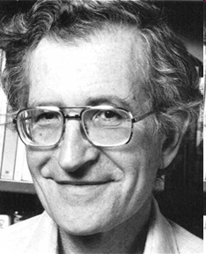
The Chomsky Hierachy
A containment hierarchy of classes of formal languages
Recursively- enumerable (TM)
Context- sensitive (LBA)
Context- free
(PDA)
Regular
(DFA)

Slide 7
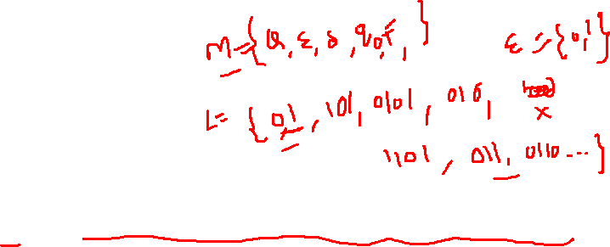
Example #1
Build a DFA for the following language:
L = {w | w is a binary string that contains 01 as a substring}
Steps for building a DFA to recognize L:
∑ = {0,1}
Decide on the states: Q
Designate start state and final state(s)
δ: Decide on the transitions:
“Final” states == same as “accepting states”
Other states == same as “non-accepting states”

Slide 8
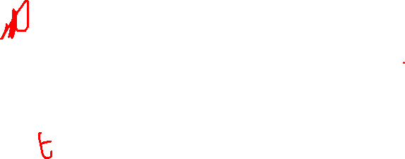
DFA for strings containing 01
Regular expression: (0+1)*01(0+1)*
What makes this DFA deterministic?
Q = {q₀,q₁,q₂}
∑ = {0,1}
start state = q₀
F = {q₂}
Transition table
1
0
0,1
start
0
1
q₀
q₁
q₂
Accepting
state
symbols
0
1
q₀
q₁
q₀
What if the language allows empty strings?
q₁
q₁
q₂
states
*q₂
q₂
q₂

Slide 9
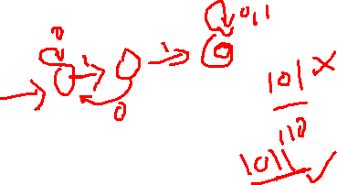
Example #2
Clamping Logic:
A clamping circuit waits for a ”1” input, and turns on forever. However, to avoid clamping on spurious noise, we’ll design a DFA that waits for two consecutive 1s in a row before clamping on.
Build a DFA for the following language: L = { w | w is a bit string which contains the substring 11}
State Design:
q₀ : start state (initially off), also means the most recent input was not a 1
q₁: has never seen 11 but the most recent input was a 1
q₂: has seen 11 at least once

Slide 10
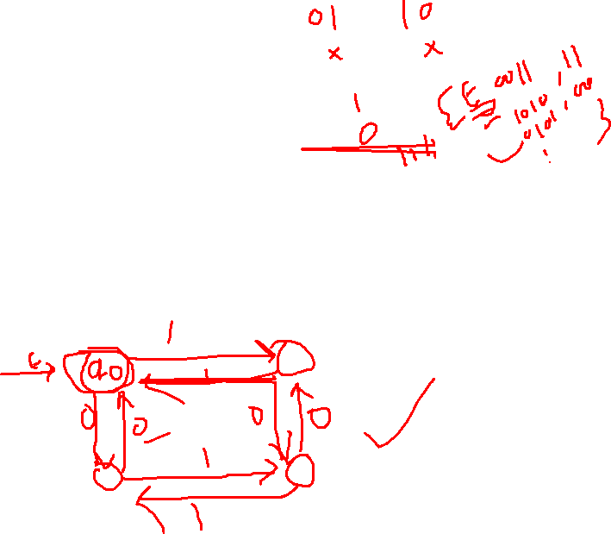
Example #3
Build a DFA for the following language: L = { w | w is a binary string that has even number of 1s and even number of 0s}
?

Slide 11
Extension of transitions (δ) to Paths (δ)
δ (q,w) = destination state from state q on input string w
δ (q,wa) = δ (δ(q,w), a)
Work out example #3 using the input sequence w=10010, a=1:
δ (q₀,wa) = ?

Slide 12
Language of a DFA
A DFA A accepts string w if there is a path from q₀ to an accepting (or final) state that is labeled by w
i.e., L(A) = { w | δ(q₀,w) ∈ F }
I.e., L(A) = all strings that lead to an accepting state from q₀

Slide 13
Non-deterministic Finite Automata (NFA)
A Non-deterministic Finite Automaton (NFA)
is of course “non-deterministic”
Implying that the machine can exist in more than one state at the same time
Transitions could be non-deterministic
1
q_{j}
q_{i}
…
Each transition function therefore maps to a set of states
1
q_{k}

Slide 14
Non-deterministic Finite Automata (NFA)
A Non-deterministic Finite Automaton (NFA) consists of:
Q ==> a finite set of states
∑ ==> a finite set of input symbols (alphabet)
q₀ ==> a start state
F ==> set of accepting states
δ ==> a transition function, which is a mapping between Q x ∑ ==> subset of Q
An NFA is also defined by the 5-tuple:
{Q, ∑ , q₀,F, δ }

Slide 15
How to use an NFA?
Input: a word w in ∑*
Question: Is w acceptable by the NFA?
Steps:
Start at the “start state” q₀
For every input symbol in the sequence w do
Determine all possible next states from all current states, given the current input symbol in w and the transition function
If after all symbols in w are consumed and if at least one of the current states is a final state then accept w;
Otherwise, reject w.

Slide 16
NFA for strings containing 01
Regular expression: (0+1)*01(0+1)*
Why is this non-deterministic?
Q = {q₀,q₁,q₂}
Σ = {0,1}
start state = q₀
F = {q₂}
Transition table
0,1
0,1
start
0
1
q₀
q₁
q₂
Final
state
symbols
0
1
What will happen if at state q₁ an input of 0 is received?
q₀
{q₀,q₁}
{q₀}
states
q₁
Φ
{q₂}
*q₂
{q₂}
{q₂}

Slide 17
Exactly two no of 1’s

Slide 18
What is an “error state”?
Note: Omitting to explicitly show error states is just a matter of design convenience (one that is generally followed for NFAs), and i.e., this feature should not be confused with the notion of non-determinism.
A DFA for recognizing the key word “while”
An NFA for the same purpose:
w
h
i
l
e
q₀
q₁
q₂
q₃
q₄
q₅
Any other input symbol
q_{err}
Any symbol
w
h
i
l
e
q₀
q₁
q₂
q₃
q₄
q₅
Transitions into a dead state are implicit

Slide 19
Example #2
Build an NFA for the following language: L = { w | w ends in 01}
?
Other examples
Keyword recognizer (e.g., if, then, else, while, for, include, etc.)
Strings where the first symbol is present somewhere later on at least once

Slide 20
Extension of δ to NFA Paths
Basis: δ (q,ε) = {q}
Induction:
Let δ (q₀,w) = {p₁,p₂…,p_{k}}
δ (p_{i},a) = S_{i} for i=1,2...,k
Then, δ (q₀,wa) = S₁ U S₂ U … U S_{k}

Slide 21
Language of an NFA
An NFA accepts w if there exists at least one path from the start state to an accepting (or final) state that is labeled by w
L(N) = { w | δ(q₀,w) ∩ F ≠ Φ }

Slide 22
Advantages & Caveats for NFA
Great for modeling regular expressions
String processing - e.g., grep, lexical analyzer
Could a non-deterministic state machine be implemented in practice?
Probabilistic models could be viewed as extensions of non-deterministic state machines (e.g., toss of a coin, a roll of dice)
They are not the same though
A parallel computer could exist in multiple “states” at the same time

Slide 23
Differences: DFA vs. NFA
But, DFAs and NFAs are equivalent in their power to capture langauges !!
DFA
All transitions are deterministic
Each transition leads to exactly one state
For each state, transition on all possible symbols (alphabet) should be defined
Accepts input if the last state visited is in F
Sometimes harder to construct because of the number of states
Practical implementation is feasible
NFA
Some transitions could be non-deterministic
A transition could lead to a subset of states
Not all symbol transitions need to be defined explicitly (if undefined will go to an error state – this is just a design convenience, not to be confused with “non-determinism”)
Accepts input if one of the last states is in F
Generally easier than a DFA to construct
Practical implementations limited but emerging (e.g., Micron automata processor)

Slide 24
Equivalence of DFA & NFA
Theorem:
A language L is accepted by a DFA if and only if it is accepted by an NFA.
Proof:
If part:
Prove by showing every NFA can be converted to an equivalent DFA (in the next few slides…)
Only-if part is trivial:
Every DFA is a special case of an NFA where each state has exactly one transition for every input symbol. Therefore, if L is accepted by a DFA, it is accepted by a corresponding NFA.
Should be true for any L

Slide 25
Proof for the if-part
If-part: A language L is accepted by a DFA if it is accepted by an NFA
rephrasing…
Given any NFA N, we can construct a DFA D such that L(N)=L(D)
How to convert an NFA into a DFA?
Observation: In an NFA, each transition maps to a subset of states
Idea: Represent:
each “subset of NFA_states” ➔ a single “DFA_state”
Subset construction

Slide 26
NFA to DFA by subset construction
Let N = {Q_{N},∑,δ_{N},q₀,F_{N}}
Goal: Build D={Q_{D},∑,δ_{D},{q₀},F_{D}} s.t. L(D)=L(N)
Construction:
Q_{D}= all subsets of Q_{N} (i.e., power set)
F_{D}=set of subsets S of Q_{N} s.t. S∩F_{N}≠Φ
δ_{D}: for each subset S of Q_{N} and for each input symbol a in ∑:
δ_{D}(S,a) = U δ_{N}(p,a)
p in s

Slide 27
NFA to DFA construction: Example
Idea: To avoid enumerating all of power set, do “lazy creation of states”
L = {w | w ends in 01}
1
0
NFA:
DFA:
[q₀]
0
[q₀,q₁]
1
[q₀,q₂]
0,1
0
0
1
1
q₀
q₁
q₂
δ_{D} | 0 | 1
Ø | Ø | Ø
[q₀] | {q₀,q₁} | {q₀}
[q₁] | Ø | {q₂}
*[q₂] | Ø | Ø
[q₀,q₁] | {q₀,q₁} | {q₀,q₂}
*[q₀,q₂] | {q₀,q₁} | {q₀}
*[q₁,q₂] | Ø | {q₂}
*[q₀,q₁,q₂] | {q₀,q₁} | {q₀,q₂}
δ_{D} | 0 | 1
[q₀] | [q₀,q₁] | [q₀]
[q₀,q₁] | [q₀,q₁] | [q₀,q₂]
*[q₀,q₂] | [q₀,q₁] | [q₀]
δ_{N} | 0 | 1
q₀ | {q₀,q₁} | {q₀}
q₁ | Ø | {q₂}
*q₂ | Ø | Ø
0. Enumerate all possible subsets
Determine transitions
2. Retain only those states reachable from {q₀}

Slide 28
NFA to DFA: Repeating the example using LAZY CREATION
L = {w | w ends in 01}
1
0
NFA:
DFA:
[q₀]
0
[q₀,q₁]
1
[q₀,q₂]
0,1
0
0
1
1
q₀
q₁
q₂
δ_{N} | 0 | 1
q₀ | {q₀,q₁} | {q₀}
q₁ | Ø | {q₂}
*q₂ | Ø | Ø
δ_{D} | 0 | 1
[q₀] | [q₀,q₁] | [q₀]
[q₀,q₁] | [q₀,q₁] | [q₀,q₂]
*[q₀,q₂] | [q₀,q₁] | [q₀]
Main Idea:
Introduce states as you go
(on a need basis)

Slide 29
Correctness of subset construction
Theorem: If D is the DFA constructed from NFA N by subset construction, then L(D)=L(N)
Proof:
Show that δ_{D}({q₀},w) ≡ δ_{N}(q₀,w} , for all w
Using induction on w’s length:
Let w = xa
δ_{D}({q₀},xa) ≡ δ_{D}( δ_{N}(q₀,x}, a ) ≡ δ_{N}(q₀,w}

Slide 30
A bad case where #states(DFA)>>#states(NFA)
L = {w | w is a binary string s.t., the k^{th} symbol from its end is a 1}
NFA has k+1 states
But an equivalent DFA needs to have at least 2^{k} states
(Pigeon hole principle)
m holes and >m pigeons
=> at least one hole has to contain two or more pigeons

Slide 31
Applications
Text indexing
inverted indexing
For each unique word in the database, store all locations that contain it using an NFA or a DFA
Find pattern P in text T
Example: Google querying
Extensions of this idea:
PATRICIA tree, suffix tree

Slide 32
A few subtle properties of DFAs and NFAs
The machine never really terminates.
It is always waiting for the next input symbol or making transitions.
The machine decides when to consume the next symbol from the input and when to ignore it.
(but the machine can never skip a symbol)
=> A transition can happen even without really consuming an input symbol (think of consuming ε as a free token) – if this happens, then it becomes an ε-NFA (see next few slides).
A single transition cannot consume more than one (non-ε) symbol.

Slide 34
FA with ε-Transitions
We can allow explicit ε-transitions in finite automata
i.e., a transition from one state to another state without consuming any additional input symbol
Explicit ε-transitions between different states introduce non-determinism.
Makes it easier sometimes to construct NFAs
Definition: ε -NFAs are those NFAs with at least one explicit ε-transition defined.
ε -NFAs have one more column in their transition table

Slide 35
Example of an ε-NFA
L = {w | w is empty, or if non-empty will end in 01}
0,1
ε-closure of a state q, ECLOSE(q), is the set of all states (including itself) that can be reached from q by repeatedly making an arbitrary number of ε-transitions.
q₀
0
q₁
1
q₂
ε
start
q’₀
δ_{E} | 0 | 1 | ε
*q’₀ | Ø | Ø | {q’₀,q₀}
q₀ | {q₀,q₁} | {q₀} | {q₀}
q₁ | Ø | {q₂} | {q₁}
*q₂ | Ø | Ø | {q₂}
ECLOSE(q’₀)
ECLOSE(q₀)
ECLOSE(q₁)
ECLOSE(q₂)

Slide 36
Example of an ε-NFA
To simulate any transition: Step 1) Go to all immediate destination states.
Step 2) From there go to all their ε-closure states as well.
L = {w | w is empty, or if non-empty will end in 01}
0,1
Simulate for w=101:
q₀
0
q₁
1
q₂
ε
q₀’
start
ε
ε
q’₀
q₀’
q₀
1
1
δ_{E} | 0 | 1 | ε
*q’₀ | Ø | Ø | {q’₀,q₀}
q₀ | {q₀,q₁} | {q₀} | {q₀}
q₁ | Ø | {q₂} | {q₁}
*q₂ | Ø | Ø | {q₂}
Ø
q₀
x
0
ECLOSE(q’₀)
q₁
ECLOSE(q₀)
1
q₂

Slide 37
Example of another ε-NFA
To simulate any transition: Step 1) Go to all immediate destination states.
Step 2) From there go to all their ε-closure states as well.
0,1
Simulate for w=101:
?
q₀
0
q₁
1
q₂
ε
ε
1
start
q’₀
q₃
δ_{E} | 0 | 1 | ε
*q’₀ | Ø | Ø | {q’₀,q₀,q₃}
q₀ | {q₀,q₁} | {q₀} | {q_{0,}q₃}
q₁ | Ø | {q₂} | {q₁}
*q₂ | Ø | Ø | {q₂}
q₃ | Ø | {q₂} | {q₃}

Slide 38
Equivalency of DFA, NFA, ε-NFA
Theorem: A language L is accepted by some ε-NFA if and only if L is accepted by some DFA
Implication:
DFA ≡ NFA ≡ ε-NFA
(all accept Regular Languages)

Slide 39
Eliminating ε-transitions
Let E = {Q_{E},∑,δ_{E},q₀,F_{E}} be an ε-NFA
Goal: To build DFA D={Q_{D},∑,δ_{D},{q_{D}},F_{D}} s.t. L(D)=L(E)
Construction:
Q_{D}= all reachable subsets of Q_{E} factoring in ε-closures
q_{D} = ECLOSE(q₀)
F_{D}=subsets S in Q_{D} s.t. S∩F_{E}≠Φ
δ_{D}: for each subset S of Q_{E} and for each input symbol a∈∑:
Let R= U δ_{E}(p,a) // go to destination states
δ_{D}(S,a) = U ECLOSE(r) // from there, take a union of all their ε-closures
p in s
r in R
Reading: Section 2.5.5 in book

Slide 40
Example: ε-NFA ➔ DFA
L = {w | w is empty, or if non-empty will end in 01}
0,1
q₀
0
q₁
1
q₂
ε
start
q’₀
δ_{E} | 0 | 1 | ε
*q’₀ | Ø | Ø | {q’₀,q₀}
q₀ | {q₀,q₁} | {q₀} | {q₀}
q₁ | Ø | {q₂} | {q₁}
*q₂ | Ø | Ø | {q₂}
δ_{D} | 0 | 1
*{q’₀,q₀}
…

Slide 41
Example: ε-NFA ➔ DFA
L = {w | w is empty, or if non-empty will end in 01}
0,1
0
{q₀,q₁}
0
0
1
{q₀,q₂}
q₀
q₁
q₂
0
1
ε
0
{q’₀, q₀}
1
start
start
1
q’₀
q₀
1
ECLOSE
union
δ_{E} | 0 | 1 | ε
*q’₀ | Ø | Ø | {q’₀,q₀}
q₀ | {q₀,q₁} | {q₀} | {q₀}
q₁ | Ø | {q₂} | {q₁}
*q₂ | Ø | Ø | {q₂}
δ_{D} | 0 | 1
*{q’₀,q₀} | {q₀,q₁} | {q₀}
{q₀,q₁} | {q₀,q₁} | {q₀,q₂}
{q₀} | {q₀,q₁} | {q₀}
*{q₀,q₂} | {q₀,q₁} | {q₀}

Slide 42
Summary
DFA
Definition
Transition diagrams & tables
Regular language
NFA
Definition
Transition diagrams & tables
DFA vs. NFA
NFA to DFA conversion using subset construction
Equivalency of DFA & NFA
Removal of redundant states and including dead states
ε-transitions in NFA
Pigeon hole principles
Text searching applications

